Slide 1
Data Analytics Lesson 5 HDFS & Setting up Hortonworks Sandbox in Azure
Jeffrey Strickland, Ph.D.

Slide 2

What is Required by Data Analytics?
Integrate
Analyze
Visualize
V1 | V2 | V3 | V4
1 | 14.23 | 1.71 | 2.43
1 | 13.20 | 1.78 | 2.14
1 | 13.16 | 2.36 | 2.67
1 | 14.37 | 1.95 | 2.50
1 | 13.24 | 2.59 | 2.87

Slide 3
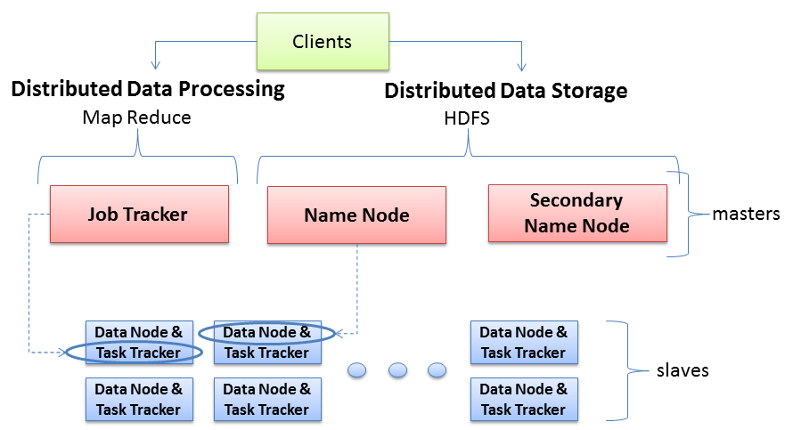
Hadoop Server Roles
NameNode stores MetaData (No of Blocks, On Which Rack which DataNode the data is stored and other details) about the data being stored in DataNodes whereas the DataNode stores the actual Data.
Secondary NN contains the name space image, edit log files' back up for past one hour (configurable). And its work is to merge latest Name Node NameSpaceImage and edit logs files to upload back to Name Node as replacement of the old one
Technical Sense: JobTracker is a master which creates and runs the job. JobTracker which can run on the NameNode allocates the job to TaskTrackers which run on DataNodes; TaskTrackers run the tasks and report the status of task to JobTracker.
two key functional pieces
Oversees and coordinates the parallel processing of data
Oversees and coordinates the data storage function (HDFS)
Physical Sense: The JobTracker runs on MasterNode aka NameNode whereas TaskTrackers run on DataNodes.

Slide 4
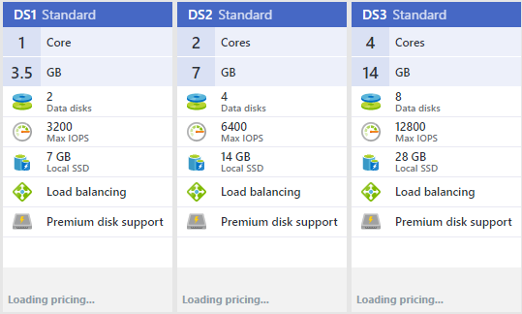
Virtual Machine Configuration
At least 2 Cores
At least 6400 Input/Output Operations Per Second (IOPS)
At least 4 GB
At leasr 4 Data Disks

Slide 5
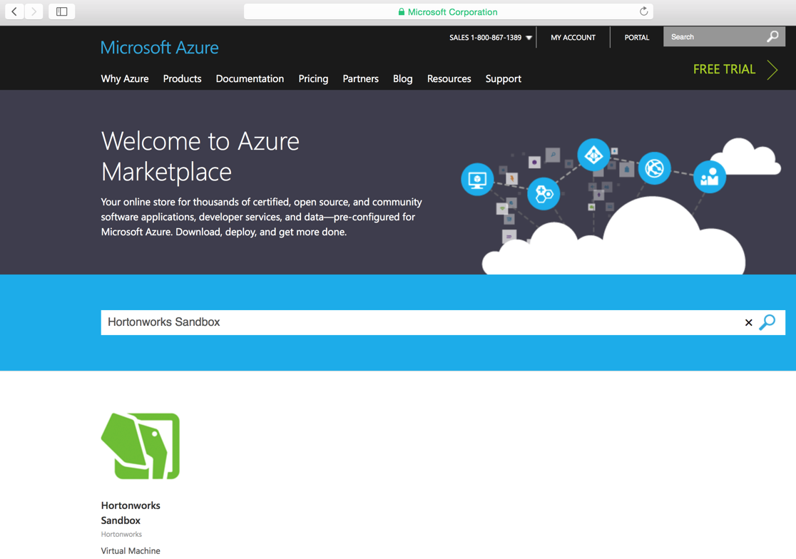
1. Go to https://azure.microsoft.com/en-us/marketplace/ and type in “Hortonworks Sandbox” in the search bar and hit enter. The following page displays.

Slide 6
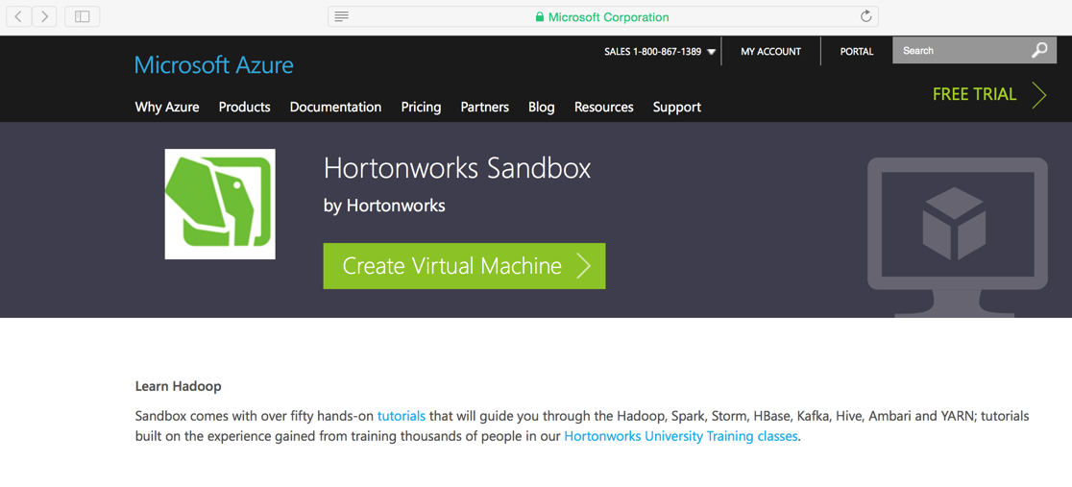
2. Click on the “Hortonworks Sandbox” offering. The next page displayed will be the landing page with some information. On this page click on the “Create Virtual Machine” button.

Slide 7
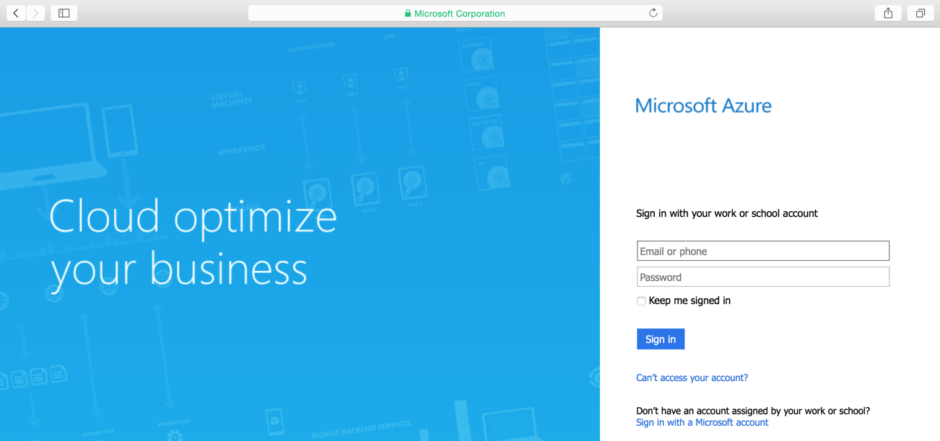
3. If not yet logged in, the following page will be displayed. Enter your credentials.

Slide 8
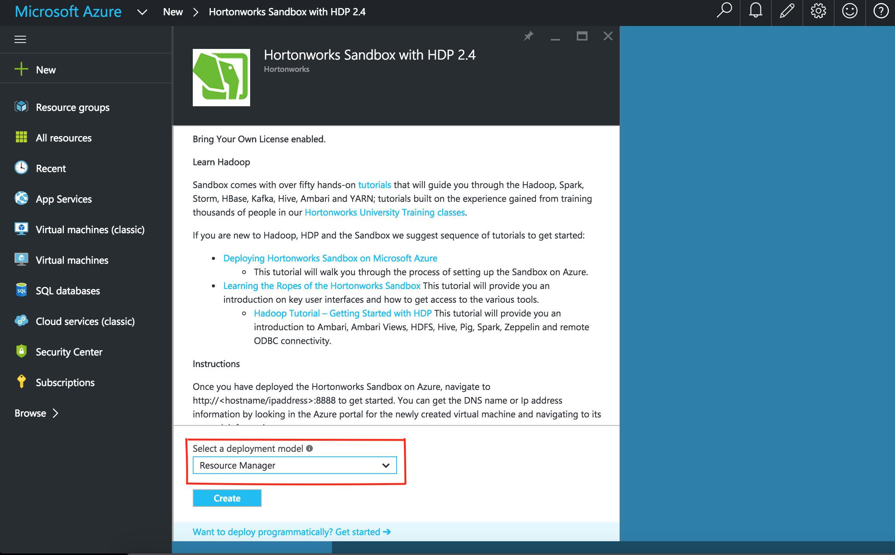
4. After logging in, the following page is presented. Select “Resource Manager” from the drop down field “Select a deployment model” field. Microsoft suggests to always use the Resource Manager deployment model. More information on the Resource Manager can be found here . After making the selection, click “Create”.

Slide 9
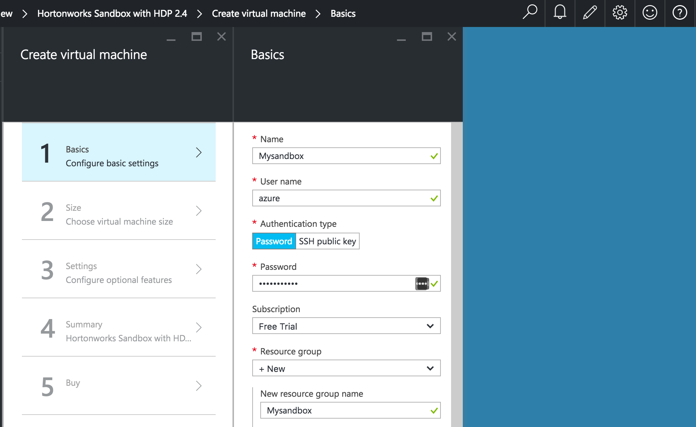
5. After clicking create, you see a two new sections that will walk you through in entering information about the virtual machine being provisioned. Below shows a screenshot of the fields filled out.

Slide 10
6. Enter a value for each of the fields. Below is an explanation of the fields.
Name: This is the name you want to reference the machine. You can choose any name to your liking. In the example above, “Mysandbox” was the name given to the machine.
User name: This is the name of the user account used to log into the machine. In this example, “azure” is the user name chosen.
Authentication type: This field allows a choice to either use a password or an SSH public key. This is needed when using an ssh client to access the virtual machine for any specific reason. If you are not familiar using SSH, simply select password and enter a password that satisfies 3 of the following:
1 lower case character
1 upper case character
1 digit
1 special character
If you are familiar with using SSH, proceed in selecting “SSH public key” and enter in your public SSH key.
Subscription: This depends on your account. The example used above is set to “Free Trial”.
Resource group: This is the name of the resource group you want to create. You can also select an existing group if you like. Suggestion is to create a new resource group. In the example, we create a resource group name that is the same name as the machine “Mysandbox”.
Location: This field allows selection of the region where the machine is deployed.

Slide 11
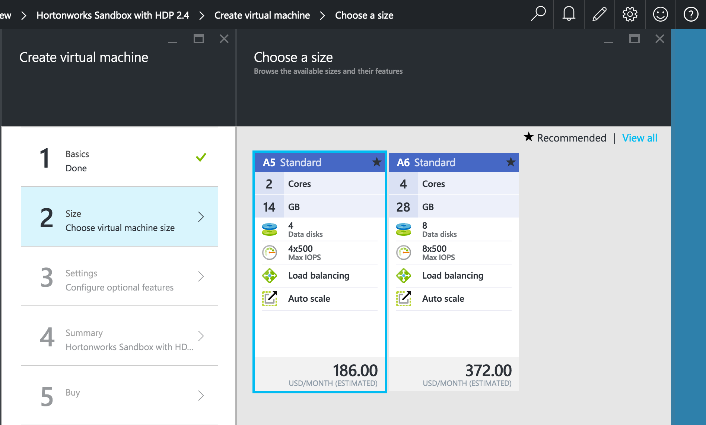
7. After entering values for the fields click OK. The following sections are then presented:

Slide 12
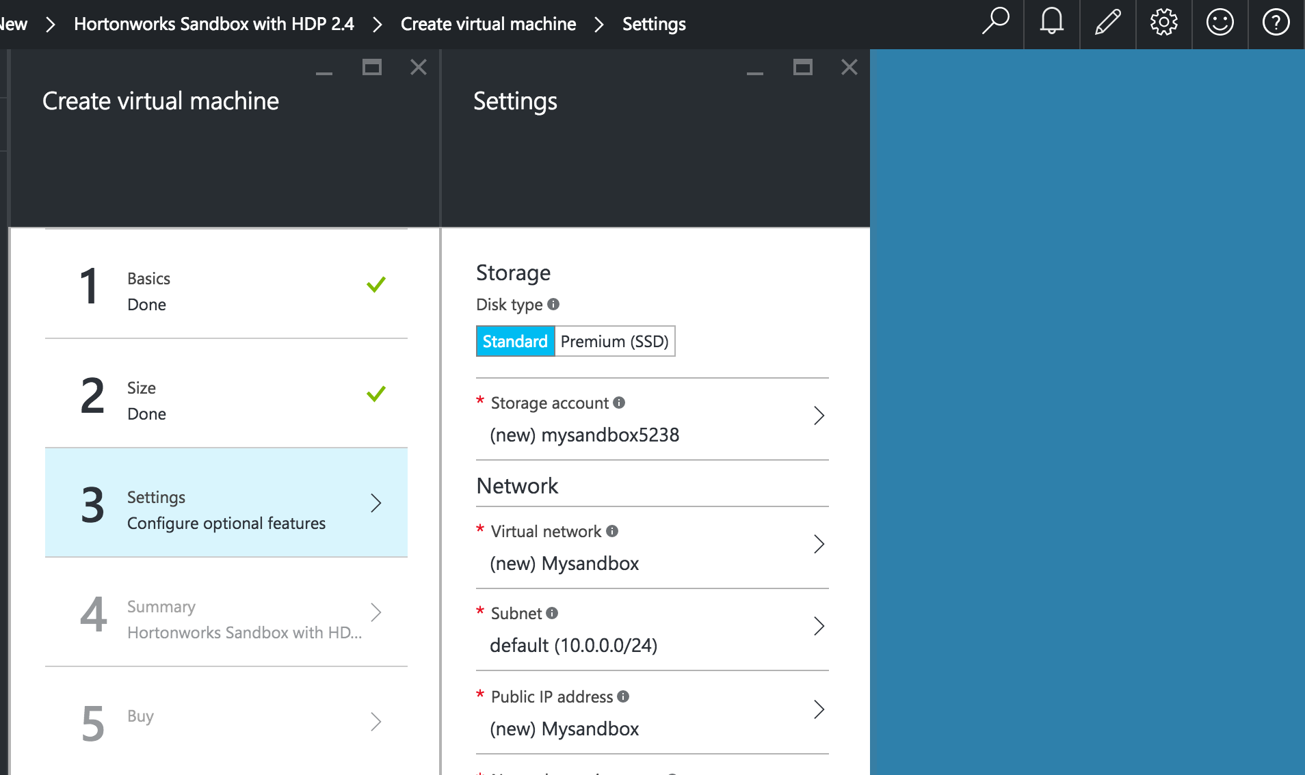
8. Here you can select the machine to run the Sandbox. The suggestion is to use a machine equivalent or higher than an A4 spec’d machine. After selecting the machine, click on the select button.

Slide 13
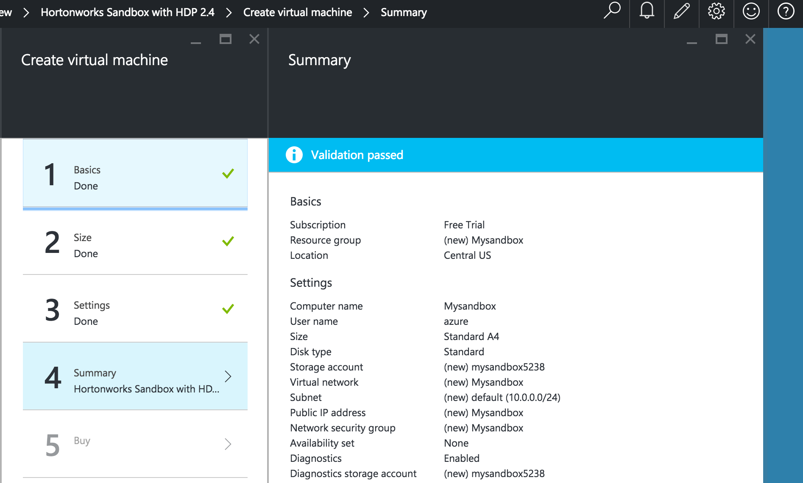
9. The next prompt is a list of settings. You can simply leave these as defaults and click “OK”. The next screen is the summary.

Slide 14
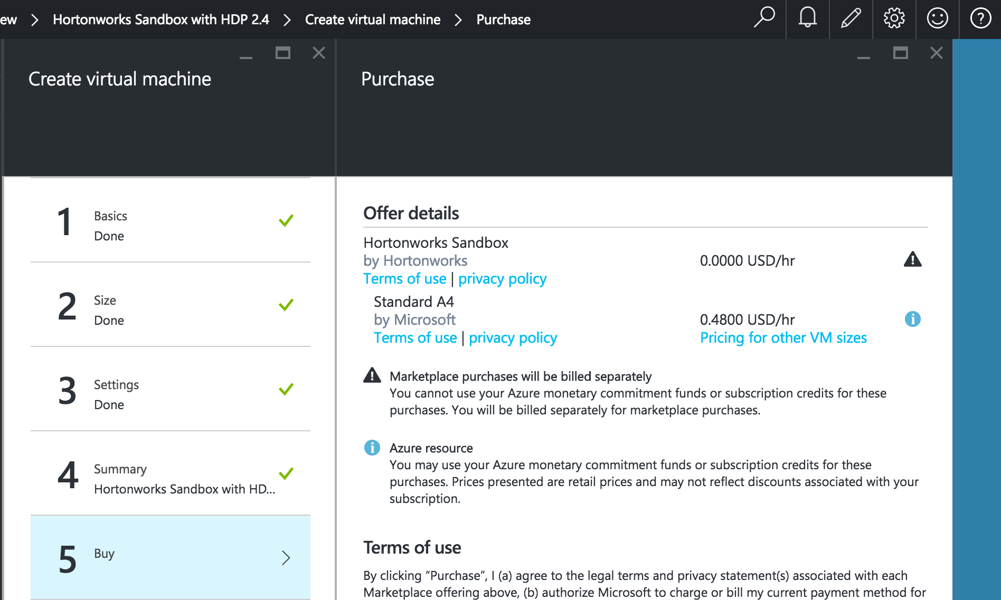
10. Ensure the information looks correct for the specific items you have entered and selected. If all looks well, click the “OK” button.

Slide 15
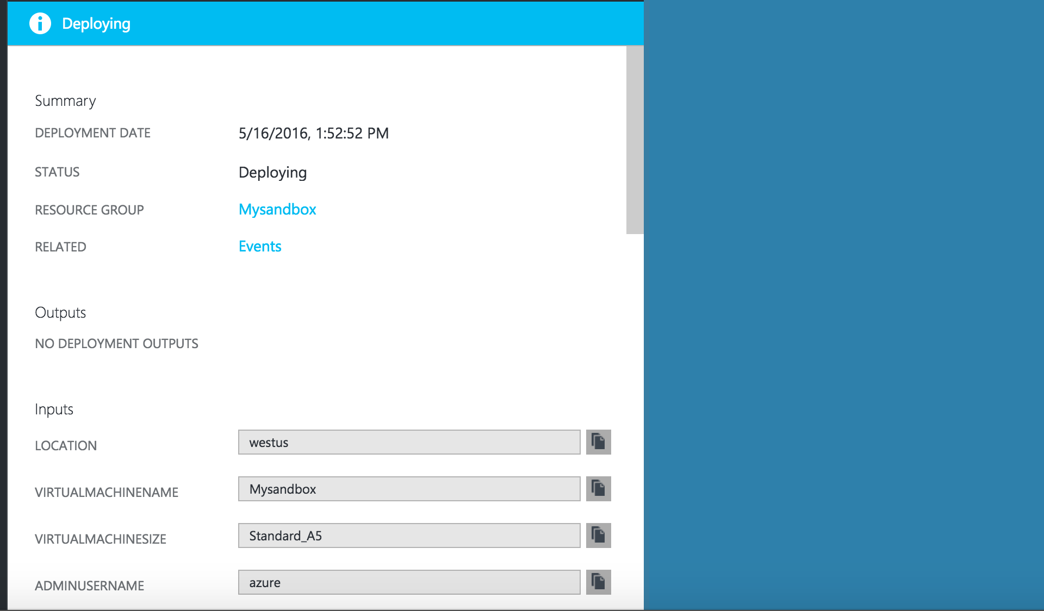
11. The last step in this section is to click purchase. You will be brought back to the dashboard. Click on the top bar bell to view the progress. Shows the following screen.

Slide 16
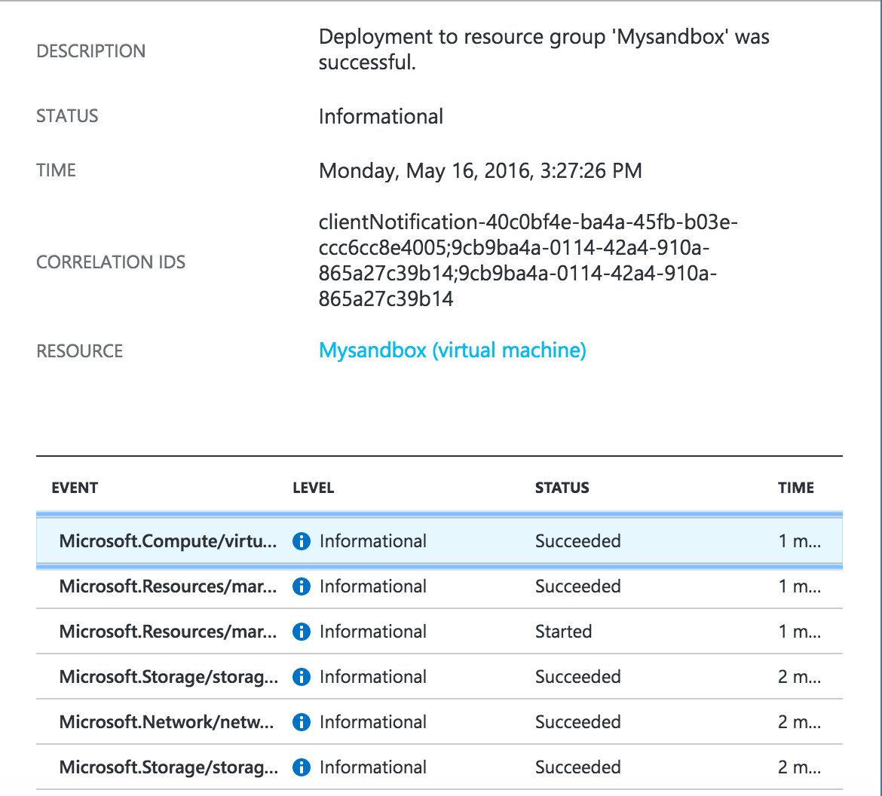
After some time, you see

Slide 17
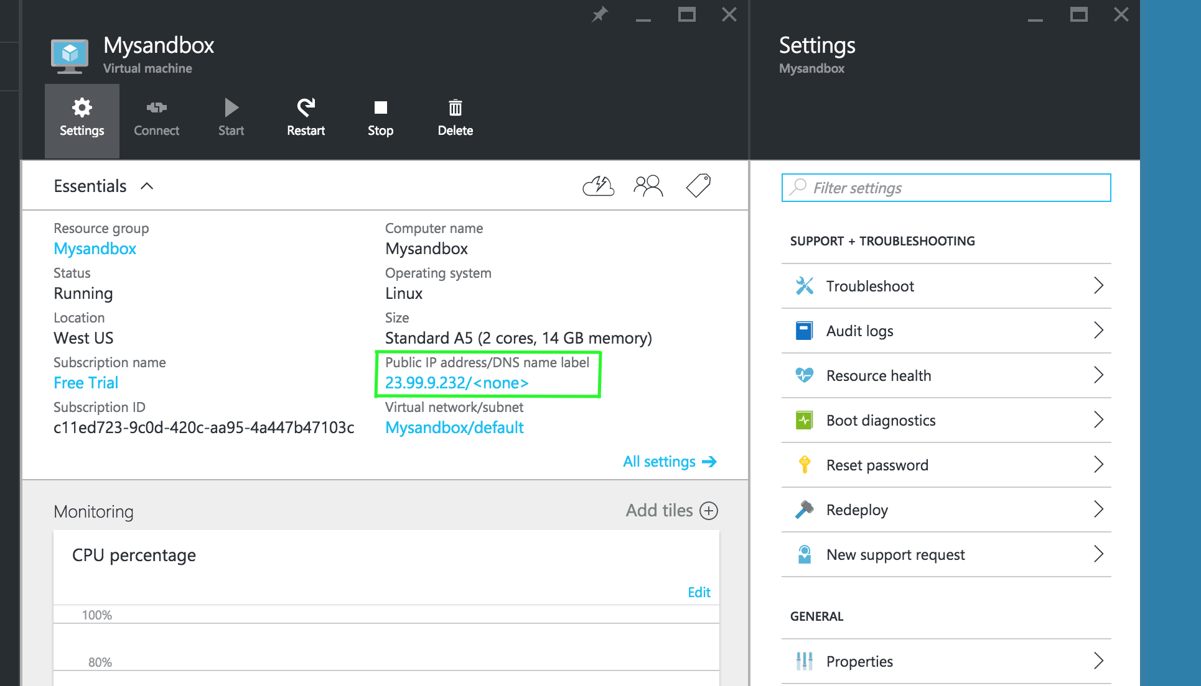
Once the virtual machine is deployed the following screen is displayed in the portal.

Slide 18
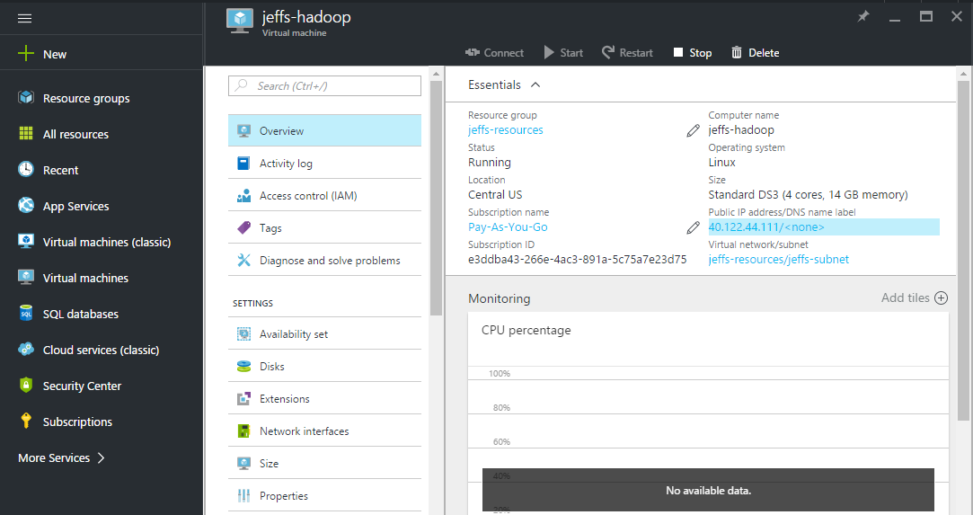
12. Take note of the IP address. In this example, it is 22.99.9.232 and highlighted in a green box. Your machine will have a different IP. Open up a new browser tab and enter in your IP address followed by the port 8888.

Slide 19
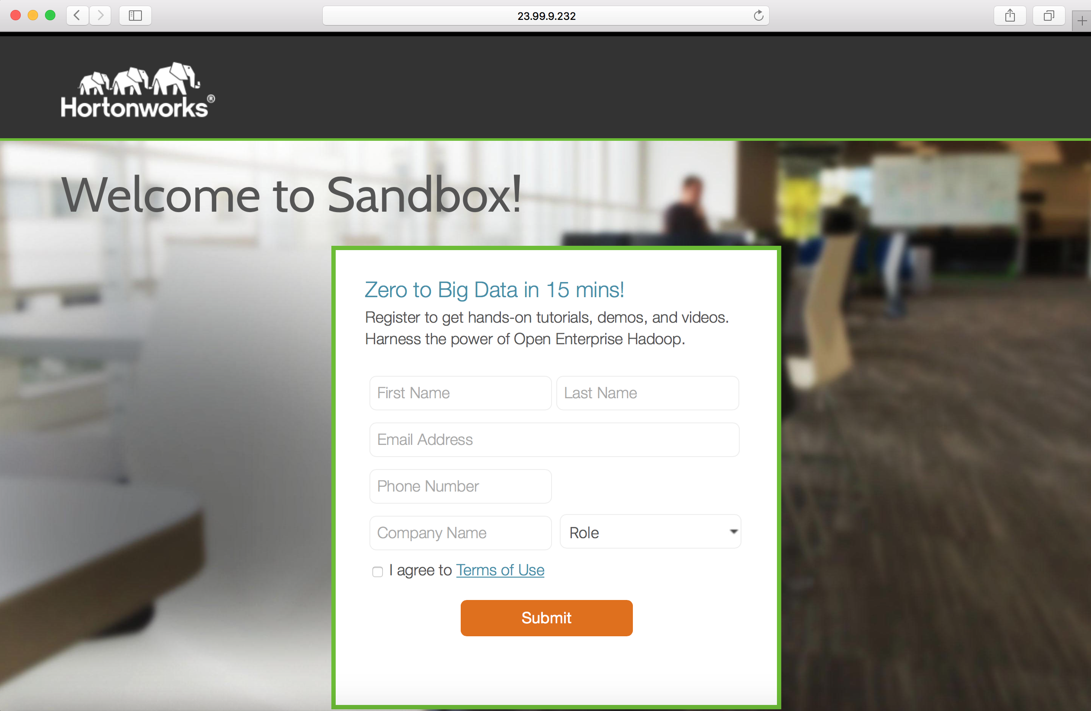
13. Hit enter and you should be welcomed with the following registration page.

Slide 20
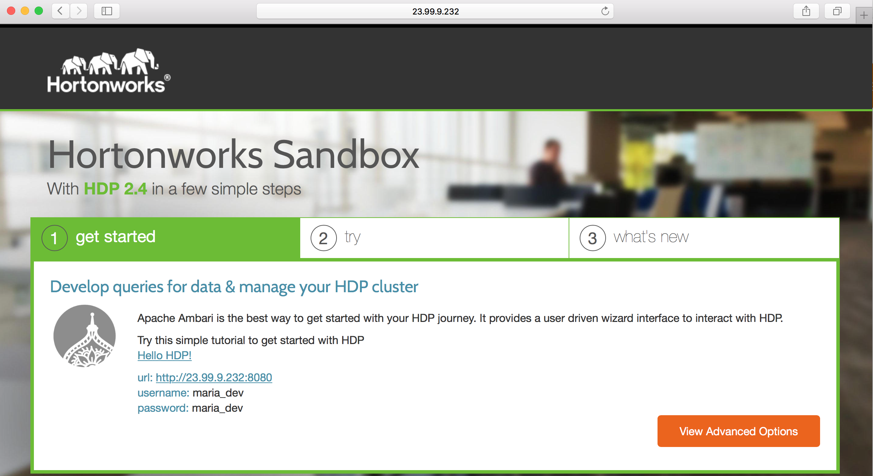
14. Fill out the form, agree to the terms of use and click the submit button. The next page displayed is the splash page.

Slide 21
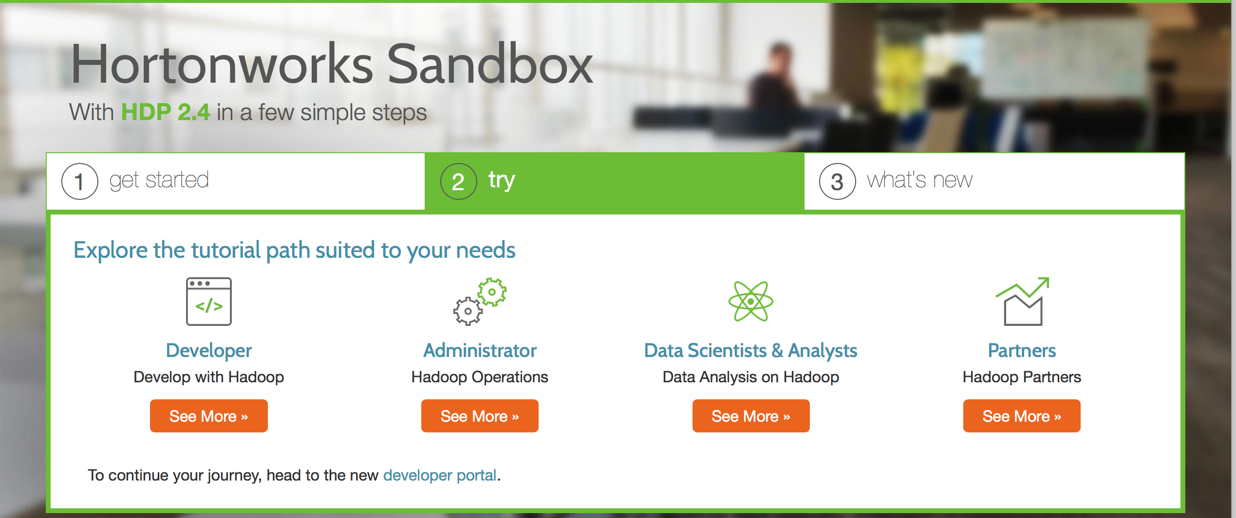
15. Follow the tutorial here to explore more about the Sandbox in Azure part. 16. If you are new to HDP, start your journey by clicking on the link to the Hello HDP!.

Slide 22
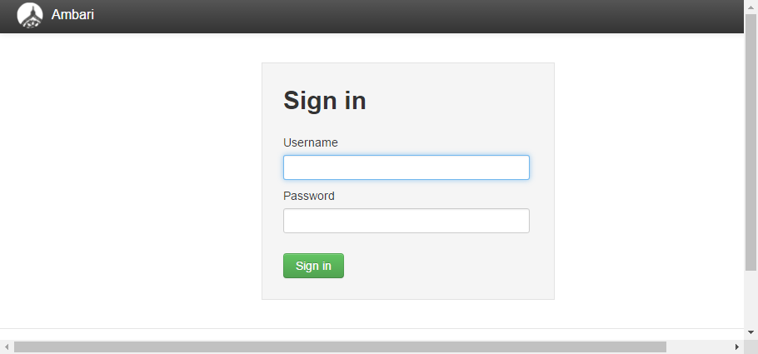
Ambari login is http://40.122.44.111:8080/#/login

Slide 23
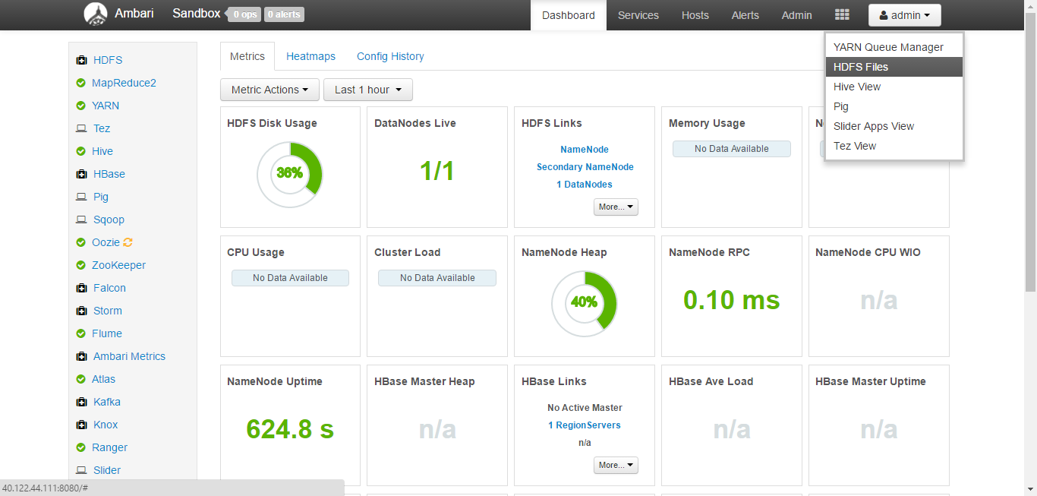
Ambari Dashboard View with Application Menu

Slide 24
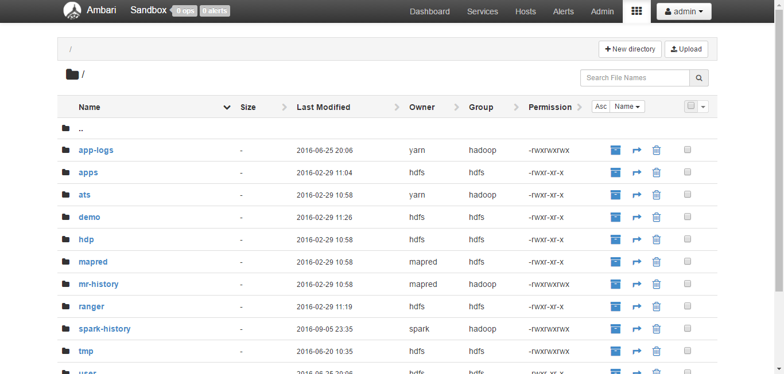
Hadoop Distributed File System (HDFS)

Slide 25
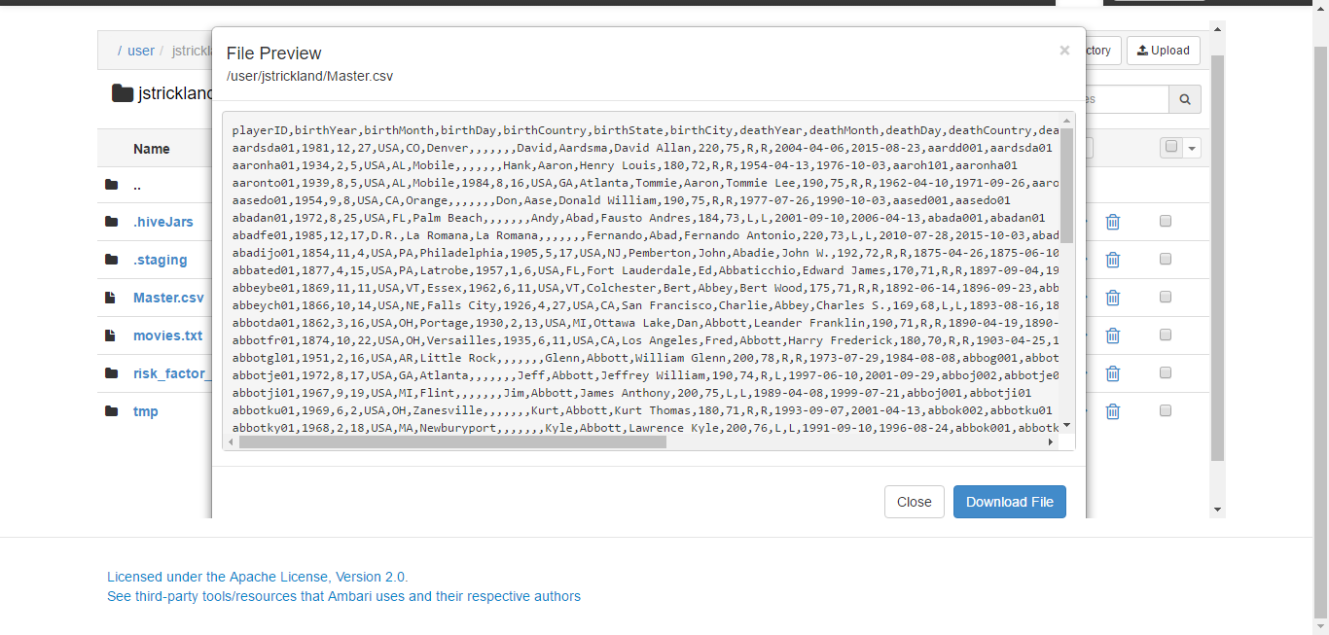
/user/jstrickland/Master.csv

Slide 26
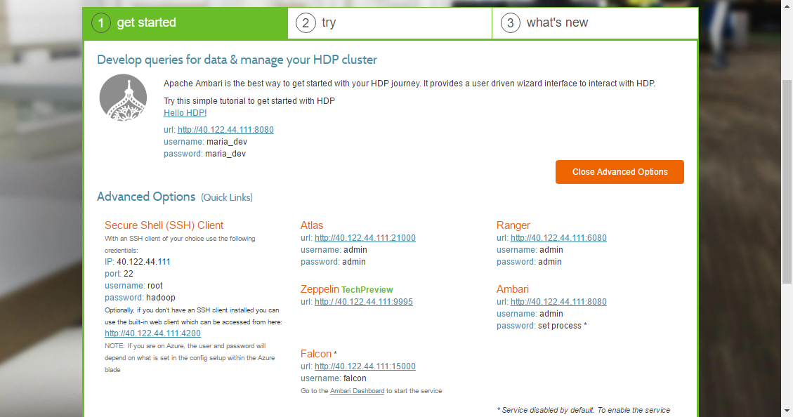
<hostname>:8888 and select Advance Options, then choose Secure Shell (SSH) Client <hostname>:4200

Slide 27
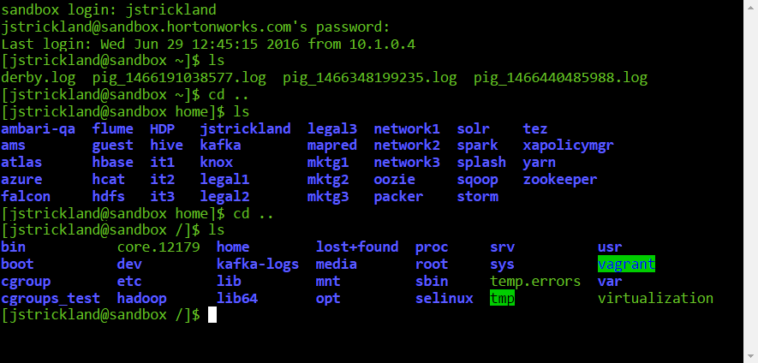
Sandbox Terminal Login

Slide 28
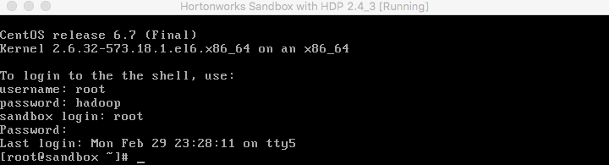
VM Terminal Method:
Open the Sandbox through Virtualbox or VMware.
The Sandbox VM Welcome Screen will appear.
To login into the Sandbox VM Terminal For Linux/Windows users,
press Alt+F5
and for Mac,
press Fn+Alt+F5 .

Slide 29
Shell Web Client Method:
Open your web browser. Type the following text into your browser to access the Sandbox through the shell:
# Usage:
# _host_:4200
Example:
127.0.0.1:4200

Slide 30
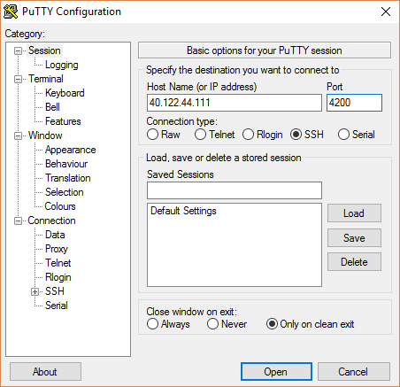
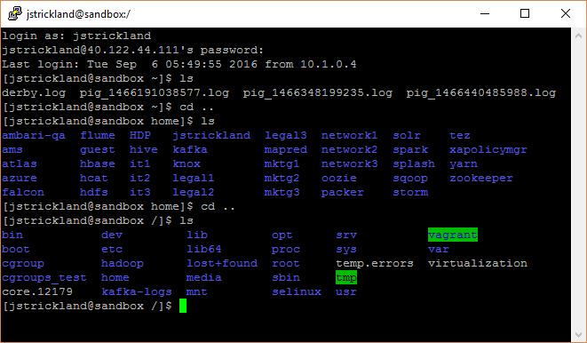
Secure Shell (SSH) Method:
Open your terminal (mac and linux) or putty (windows). Type the following command to access the Sandbox through SSH:
# Usage:
ssh <username>@<hostname> -p <port>;
# Example:
ssh root@127.0.0.1 -p 2222;

Slide 31
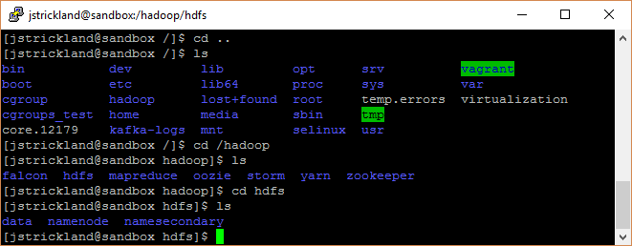
[jstickland@sandbox /]$ cd /hadoop/hdfs list files using ls
Data, namenode, namesecondary

Slide 32
Send Data from Local Machine to Sandbox
Open your terminal (linux or mac) or git bash (windows).
To send data, in our example HDF .tar.gz file, from your local machine to the azure sandbox, you would input the the following command.
If you want to try this command, replace the HDF filename with another filename from your Downloads folder. Modify the command and execute:
scp -P 2222 ~/Downloads/HDF-1.2.0.1-1.tar.gz root@localhost:/root
This command sends HDF from your local machine’s Downloads folder to the Sandbox’s root directory.
We can send any file, directory we want, we just need to specify the path.
We can also choose any sandbox directory or path that we want the data to land into.
Here is the definition of the command that we used above:
scp -P <input-port> </input-directory-path-local-mach> <input-username@hostname-:/sandbox-dir-path>

Slide 33
Send Data from Sandbox to Local Machine
We can also send data from sandbox to our local machine, refer to the modified command definition below:
scp -P <input-port> <input-username@hostname-:/sandbox-dir-path> </input-directory-path-local-mach>
What is the difference between the two command definitions above? To send data from local machine to sandbox, the local machine directory path comes before sandbox directory.
To transfer data from sandbox to local machine, the command arguments are reversed.

Slide 34
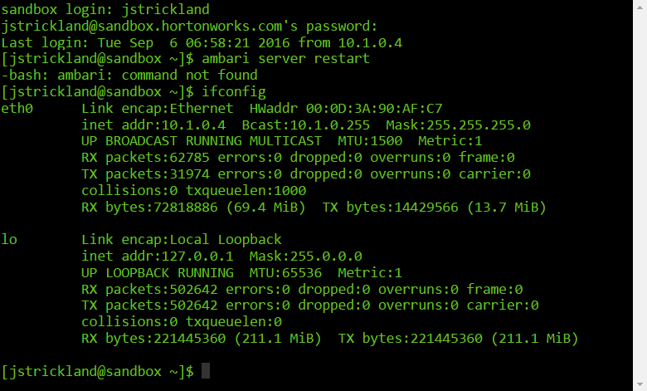
Use Terminal To Find The Host IP Sandbox Runs On
If you want to search for the host address your sandbox is running on, ssh into the sandbox terminal upon successful installation and follow subsequent steps:
Login using username as root and password as hadoop.
Type ifconfig and look for inet addr: under lo.
Use the inet addr, append :8080 and open it into a browser. It shall direct you to Ambari login page.
This inet address is randomly generated for every session and therefore differs from session to session.

Slide 35
Services Provided by the Sandbox
Service | URL
Sandbox Welcome Page | http://host:8888
Ambari Dashboard | http://host:8080
Ambari Welcome | http://host:8080/views/ADMIN_VIEW/2.2.1.0/INSTANCE/#/
Hive User View | http://host:8080/#/main/views/HIVE/1.0.0/AUTO_HIVE_INSTANCE
Pig User View | http://host:8080/#/main/views/PIG/1.0.0/Pig
File User View | http://host:8080/#/main/views/FILES/1.0.0/Files
SSH Web Client | http://host:4200
Hadoop Configuration | http://host:50070/dfshealth.html http://host:50070/explorer.html

Slide 36
Login Credentials
Service | User | Password
Ambari | maria_dev | maria_dev
Ambari | admin | refer to step 2.2
Linux OS | root | hadoop

Slide 37
Setup Ambari Admin Password Manually
Start your sandbox and open a terminal (mac or linux) or putty (windows)
SSH into the sandbox as root using ssh root@127.0.0.1 -p 2222. For Azure and VMware users, your _host_ and _port_ will be different.
Type the following commands:
# Updates password
ambari-admin-password-reset
# If Ambari doesn't restart automatically, restart ambari service
ambari-agent restart

Slide 38
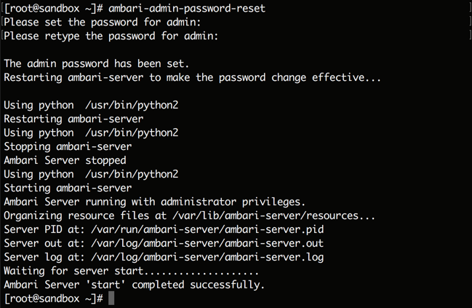
Ambari Admin Login
Now you can login to ambari as an admin user to perform operations, such as starting and stopping services.

Slide 39
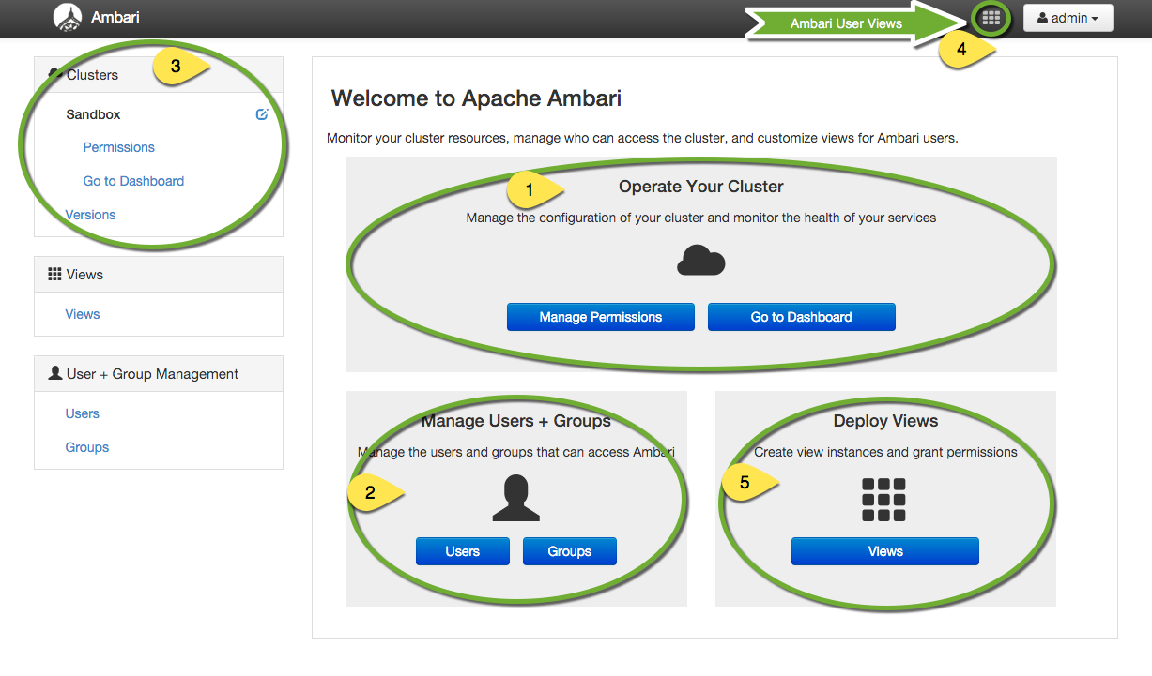
Enter the Ambari Welcome URL and then you should see a similar screen:

Slide 40
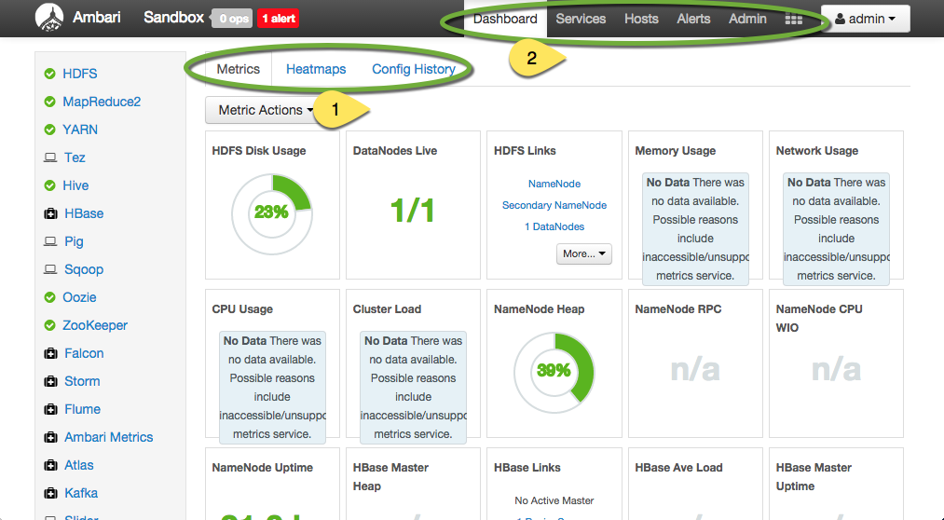
The Distributed File System: HDFS

Slide 41
Sanbox in Azure
Append the port number :8888 to your host address, open your browser, and access Sandbox Welcome page at http://_host_:8888/.
Here, host is your public IP address that is generated when you deployed the HDP Sandbox in Azure. Take note of the IP address.
In this example, it is 23.99.9.232, but your machine will have a different IP.

Slide 42
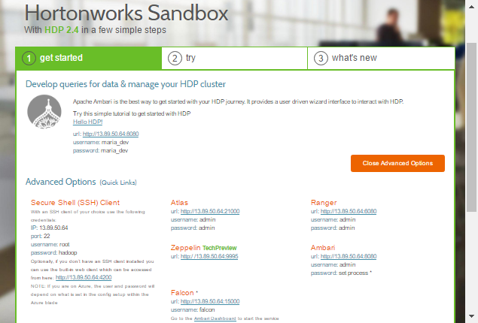
Horton Sandbox Welcome Screen

Slide 43
Summary: Move Data Between Sanbox and Local Machine
Send data to Sanbox
Definition
Send data to Local Machine
scp -P 2222 ~/Downloads/HDF-1.2.0.1-1.tar.gz james94@localhost:/james94
scp -P <input-port> </input-directory-path-local-mach> <input-username@hostname-:/sandbox-dir-path>
scp -P <input-port> <input-username@hostname-:/sandbox-dir-path> </input-directory-path-local-mach>

Slide 44
Contact Information
E-mail: jeff@humalytica.com
LinkedIn: https://www.linkedin.com/in/jeffreystrickland
Web site: www.humalytica.com
Skype: jeffrey.strickland2

